Slide 1

EXCEL ENGINEERING COLLEGE (AUTONOMOUS)
Approved by AICTE, New Delhi & Affiliated to Anna University, Chennai
Accredited by NBA(AERO,AGRI,BME,CIVIL,CSE,ECE,MECH ), NAAC with “A⁺” and Recognised by UGC (2f &12B)
KOMARAPALAYAM – 637303
DEPARTMENT OF
ARTIFICIAL INTELLIGENCE & DATA SCIENCE
MAJOR PROJECT
AI-DRIVERN WILDLIFE DETERRENCE AND MOVEMENT MONITORING SYSTEM
Presenting by :
MOHAMED AQEEL M,
THARUN ATITHYA B,
BERBIN JOE J,
AARIFF M.
Guided by:
Ms.YASMIN,
AP/ AI & DS,
EXCEL ENGINEERING COLLEGE

Slide 2
PROBLEM STATEMENT:
How can we develop a practical, cost-effective, and eco-friendly Al-driven ultrasound technology to detect and deter wild animals from entering agricultural fields, while studying the movement of animals from reserve forests to human habitation areas and implementing a warning system to alert nearby localities for effective crop protection and wildlife management?
OBJECTIVE:
Detect the presence of wild animals near agricultural fields using AI-integrated sensor systems.
Identify the type of animal (e.g., elephant, wild boar, deer) using lightweight AI models at the edge.
Deter wild animals non-invasively using species-specific ultrasound frequencies that are eco-friendly and harmless.
Track movement patterns of wildlife from reserve forests to human habitations for ecological study and prevention planning.
Provide real-time alerts to local communities and authorities through SMS, mobile apps, or sirens for timely crop protection.

Slide 3
ABSTRACT:
Human-wildlife conflict is a growing concern in areas bordering forests, where wild animals frequently invade agricultural lands, causing crop damage and threatening human safety.
This project proposes a cost-effective, eco-friendly, and AI-driven ultrasound technology to detect, deter, and monitor wild animals near farmlands.
The system integrates AI-based object recognition, motion sensors, and infrared/thermal imaging to accurately detect and identify wild animals in real time.
Once an animal is detected, the system triggers adaptive ultrasound frequencies tailored to specific species, safely deterring them from entering protected areas.
IoT-based alert mechanisms notify nearby farmers and local authorities via SMS, mobile apps, and/or sirens, enabling immediate preventive action.

Slide 4
INTRODUCTION:
Human-wildlife conflict is an escalating issue in regions adjacent to forests, particularly in agricultural zones, leading to significant crop damage, economic losses, and safety concerns.
The expansion of human settlements, deforestation, and climate change have pushed wildlife to venture into farmlands in search of food and water.
Traditional methods of protecting crops—like electric fencing, noise makers, or physical barriers—are often expensive, harmful to wildlife, or unsustainable.
There is a pressing need for a non-invasive, intelligent, and eco-friendly solution that can safeguard farmlands while also preserving wildlife.
The proposed system utilizes artificial intelligence (AI) combined with ultrasound deterrent technology to detect and deter animals without causing harm.
The system employs edge computing, motion and thermal sensors, and AI-based image recognition to identify animals and assess potential threats in real time

Slide 5
LITERATURE SURVEY:
Sno. | Title | Technologies Used | Advantages | Disadvantages
1. | Smart Wildlife Monitoring using Wireless Sensor Network | WSN, ZigBee, PIR Sensors | Low power, wireless deployment, scalable | Limited detection range, low accuracy, interference in dense forests
2. | Vision-Based Animal Detection System | OpenCV, Machine Learning, CCTV Cameras | Real-time video analysis, low cost | High false positives, poor performance in low-light conditions
3. | AI-based Elephant Intrusion Detection System | Deep Learning (YOLO), Raspberry Pi, Camera | Accurate detection, suitable for large animals | High processing power needed, delay in alert messaging
4. | IoT-based Animal Intrusion Alert System | Ultrasonic Sensor, Arduino, GSM Module | Simple and cost-effective, easy to deploy | Cannot identify species, limited range, prone to false alarms

Slide 6
EXISTING SYSTEM:
Electric Fencing Provides a physical and electrical barrier.Effective for large animals like elephants and wild boars but High installation and maintenance costs, can injure animals and humans.
Manual Surveillance and Patrolling Forest staff or farmers monitor areas physically but Labor-intensive, time-consuming, low coverage, unsafe during animal encounters.
Firecrackers and Sound-based Repellents Loud noises scare away animals temporarily.
Camera Traps Motion-triggered cameras used mainly for research and monitoring.No deterrence feature, expensive, requires manual data retrieval and analysis.

Slide 7
DRAW BACKS:
Limited Range & Coverage
False Positives / Accuracy Issues
Environmental Interference
High Power Requirements / Infrastructure Needs
Cost and Complexity
Scalability Concerns
Connectivity Dependence
Animal Adaptation

Slide 8
PROPOSED SYSTEM:
The system integrates multiple technologies for effective wildlife monitoring. It uses YOLOv11 for real-time object detection, an ESP8266 microcontroller for wireless communication, an ultrasonic sensor for proximity-based deterrence, and a pan-tilt servo motor to give the camera dynamic tracking ability.
It relies on the MQTT protocol for fast, lightweight data and alert transmission, and is solar-powered, making it suitable for remote, off-grid locations.
This system is best suited for agricultural lands, wildlife buffer zones, and semi-remote locations where animal intrusion is a concern.
Its low power consumption and solar capability make it ideal for long-term deployment, while real-time detection and alerting support quick response and proactive deterrence.

Slide 9
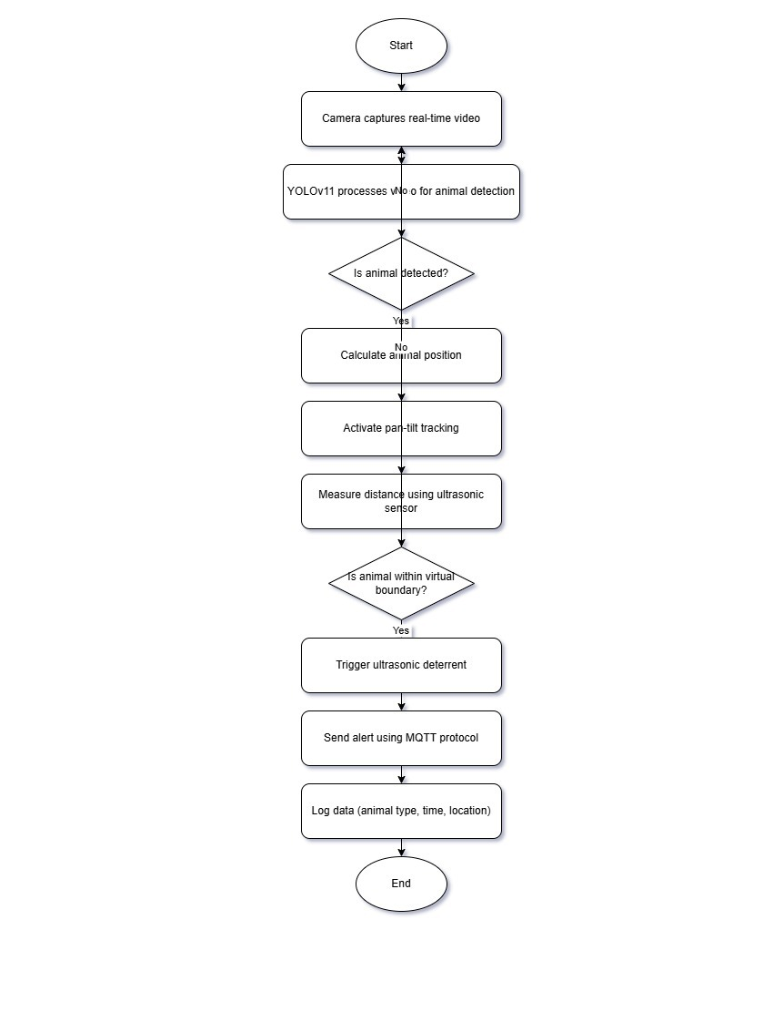
ARCHITECTURE DIAGRAM:

Slide 10
ADVANTAGES:
Accurate real-time detection using YOLOv11
Low power consumption with solar energy
Wide area coverage via pan-tilt camera
Humane animal deterrence using ultrasonic sound
Real-time alerts through MQTT protocol
Data logging for monitoring and analysis
Modular and scalable system design

Slide 11
SYSTEM REQUIREMENTS:
SOFTWARE REQUIREMENT:-
Frontend :HTML,CSS
Backend : Python
Framework : Streamlit
Hardware components:-
Ultrasonic Sensors
Thermal imaging cameras for night detection – Camera

Slide 12
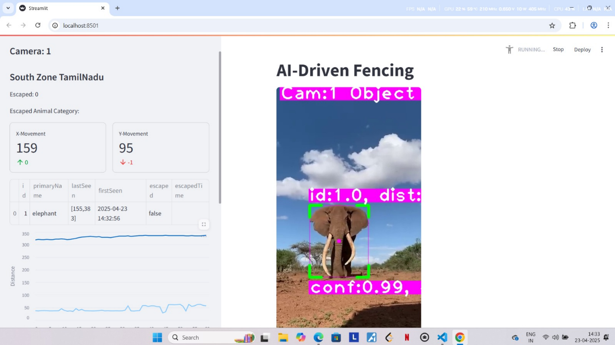
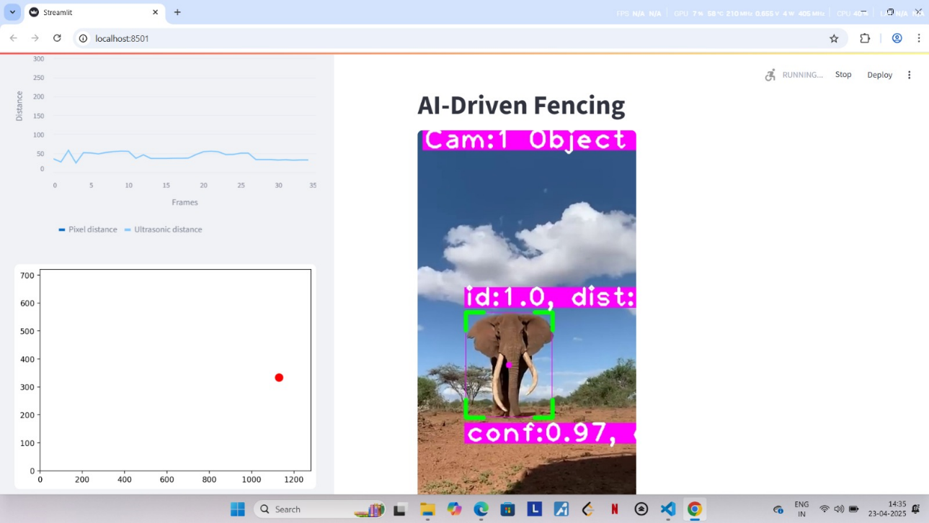
OUTPUT :

Slide 13
CONCLUSION:
AI-Driven Animal Detection and Tracking: The system successfully integrates a custom-trained YOLOv11 model for real-time animal detection and tracking, capable of identifying various species in agricultural and forested areas.
Pan-Tilt Mechanism for Tracking: The pan-tilt servo mechanism enables precise animal tracking by continuously adjusting the camera’s orientation, ensuring that the detected animal remains within the field of view at all times.
Ultrasonic Deterrence System: The project introduced an eco-friendly ultrasonic deterrent to safely and humanely repel animals without causing harm, offering a non-invasive method to protect crops and preserve wildlife habitats.
Real-Time Boundary Breach Alerts: The system utilizes MQTT protocol to send real-time alerts to local authorities and farmers when an animal crosses the predefined virtual boundary, ensuring immediate intervention to prevent crop damage.

Slide 14
REFERENCES
Redmon, Joseph, and Ali Farhadi. YOLOv3: An Incremental Improvement. April 8, 2018. arXiv. https://arxiv.org/abs/1804.02767.
Espressif Systems. ESP8266EX Datasheet. Accessed April 23, 2025. https://www.espressif.com/sites/default/files/documentation/0a-esp8266ex_datasheet_en.pdf.
MQTT.org. MQTT Version 3.1.1 Specification. Last modified 2014. https://mqtt.org/specification/.
Components101. “HC-SR04 Ultrasonic Sensor – Working and Application.” Accessed April 23, 2025. https://components101.com/sensors/hc-sr04-ultrasonic-sensor.
Arduino Project Hub. “How to Control a Pan-Tilt System with Arduino.” Accessed April 23, 2025. https://create.arduino.cc/projecthub.

